Slide 1

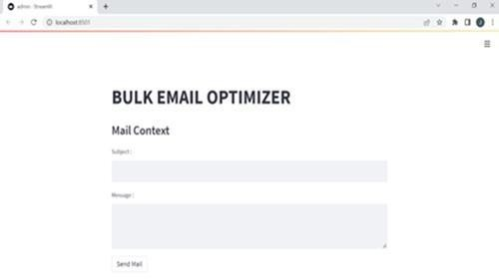
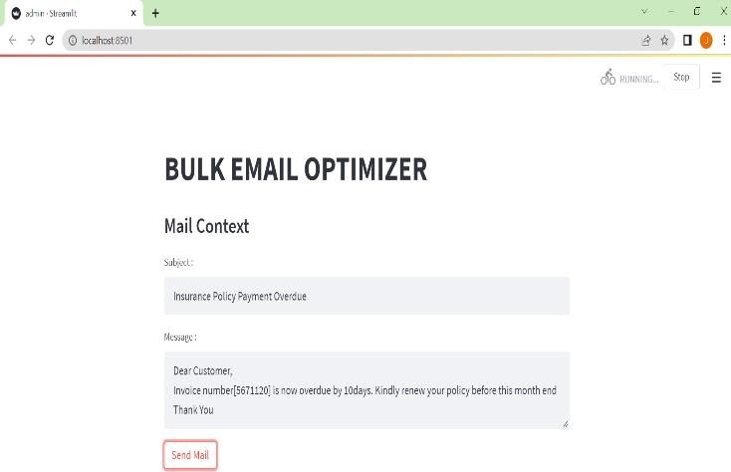
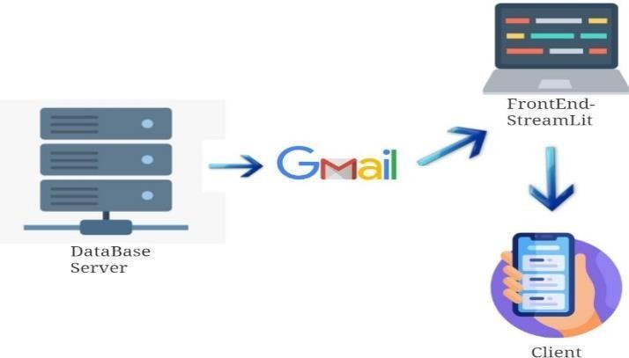
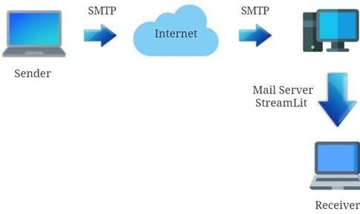
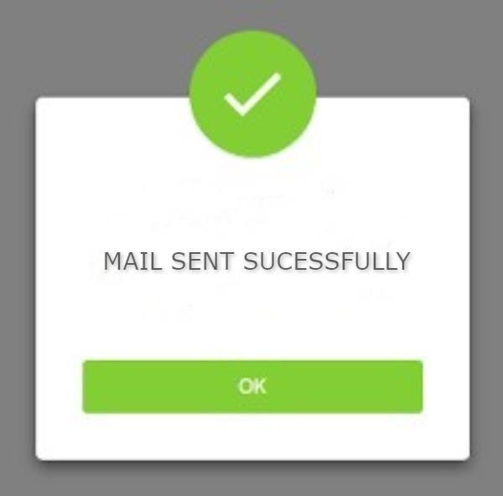
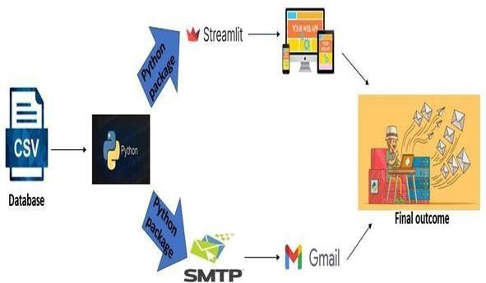
BULK EMAIL OPTIMIZATION
Introduction
Results
Bulk email generally refers to sending a number of emails to a larger audience in a short span of time. This type of service is not to be confused with free email providers like Gmail and Outlook. These services are intended for one-to-one emailing and have strict daily sending limits that make them unsuitable for sending bulk emails. This combines into one product with the flexibility of a bulk email web service.
The service is provided as a web based administration tool which is cost effective and user-friendly . With this service user can send a single message of any size to thousands of people in a fraction of second.
Frontend
Input
Output
Motivation
The main motive behind this project is to design a website to send a bulk email which can convey information to a larger audience in a short interval of time. It can include alerts, warnings and news that are of high importance and needs to be delivered to all the citizens of the country in a single go.
SCOPE of the Project
The scope of this project included :
Instant sending of large number of emails.
Reduced overhead costs and sending personalized emails.
Reach large audience in a short span.
.
Methodology
The bulk e-mail service is adaptable, shareable and measurable which implies it can be utilized to send expansive number of emails to a tremendous list of audiences in a single go. Particularly in brand promoting, it's simple for individuals to forward and share your mail content, building your reputation by word-of-mouth or viral showcasing which can offer assistance and impacts unused clients to become followers of the brand.
The first main part was deciding the topic and doing market research.
Second step involved is to collect user’s database and the user details are store it in a file.
Two python packages, Streamlit and SMTP are used.
Streamlit is used to design the frontend for the user interface.
SMTP is used to send emails to the receiver.
Streamlit SMTP Protocol
System Architecture
Conclusion
A bulk email service allows its customers to send mass email messages to multiple lists of recipients at a specified time. Existing system may includes offerings based on their respective membership plans, pricing and limitations for particular number of emails. Most of the existing bulk email service providers offer free service only for a particular trial period. So, the proposed service is provided as a web service which is cost effective and user-friendly .This offers high reliability, cost effective and the emails can be delivered instantly. It can be used in various fields like e-commerce, marketing, banking, health care, insurance policy, etc. Remainders for deadlines, payment health checkups, alert and fraud messages can be made.
References
[1] Steven Dorty 2017, ‘Send Bulk Email Free: The Definitive Guide to CostEffective Email Marketing’, ISSN: B06XBNPNZ9, pp 1 – 97
[2] Robert W. Bly 2018, ‘The New Email Revolution: Save Time, make money and Write emails ‘, ISBN: 978- 1510727915, pp 9 – 365

